Slide 1
CoCo
Collaborative Collections
Austin Chustz, Jeff Garnier, Tom Kremer

Slide 2
Overview
CoCo is a way to collaboratively create digital memories of events

Slide 3
Overall Problem & Solution
Currently, there’s no way to re-live an event.
CoCo enables you to create and curate a collection of photos and video that represent the best of the experience

Slide 4
Contextual Inquiry (Desc. & Results)
3 college students chosen because college student age bracket would be largest user population
Target customers selected to represent a spectrum of social media users
Target customers observed sharing a picture or thought on social media of choice and questioned about decisions made during the process

Slide 5
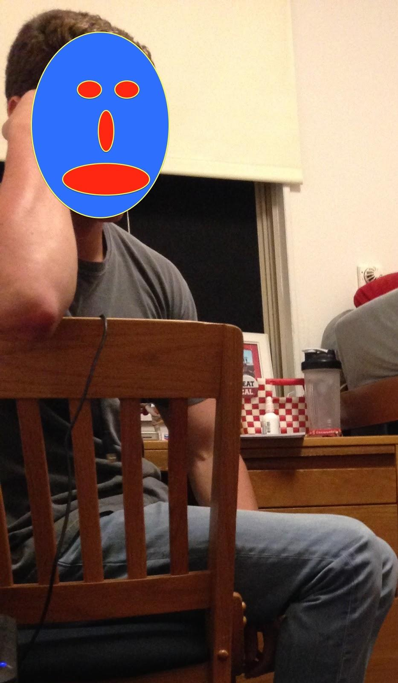
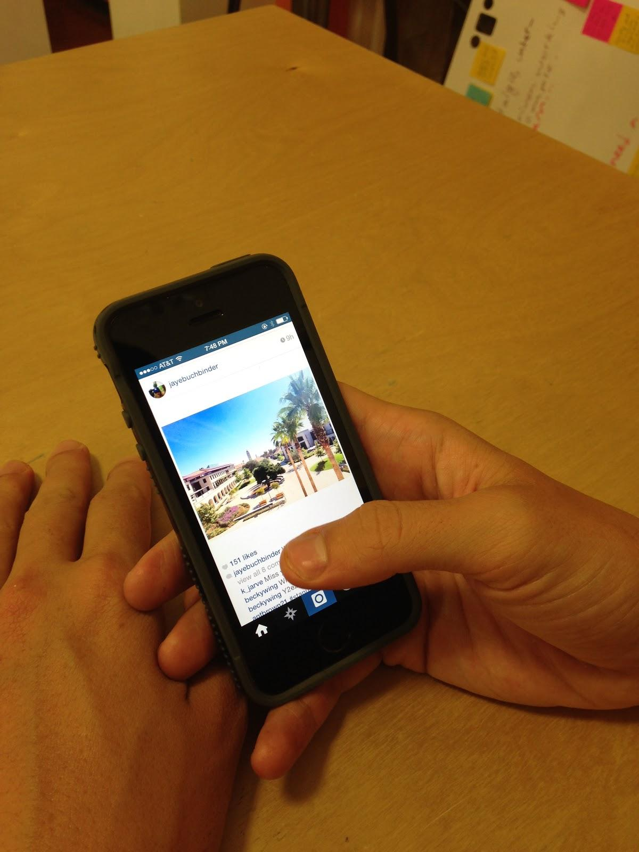
Contextual Inquiry (Desc. & Results)
Interview
Spencer
Chosen because he is a heavy Instagram user
Enjoys attending sporting events
Recruited through friends
Interviewed in college dorm room

Slide 6
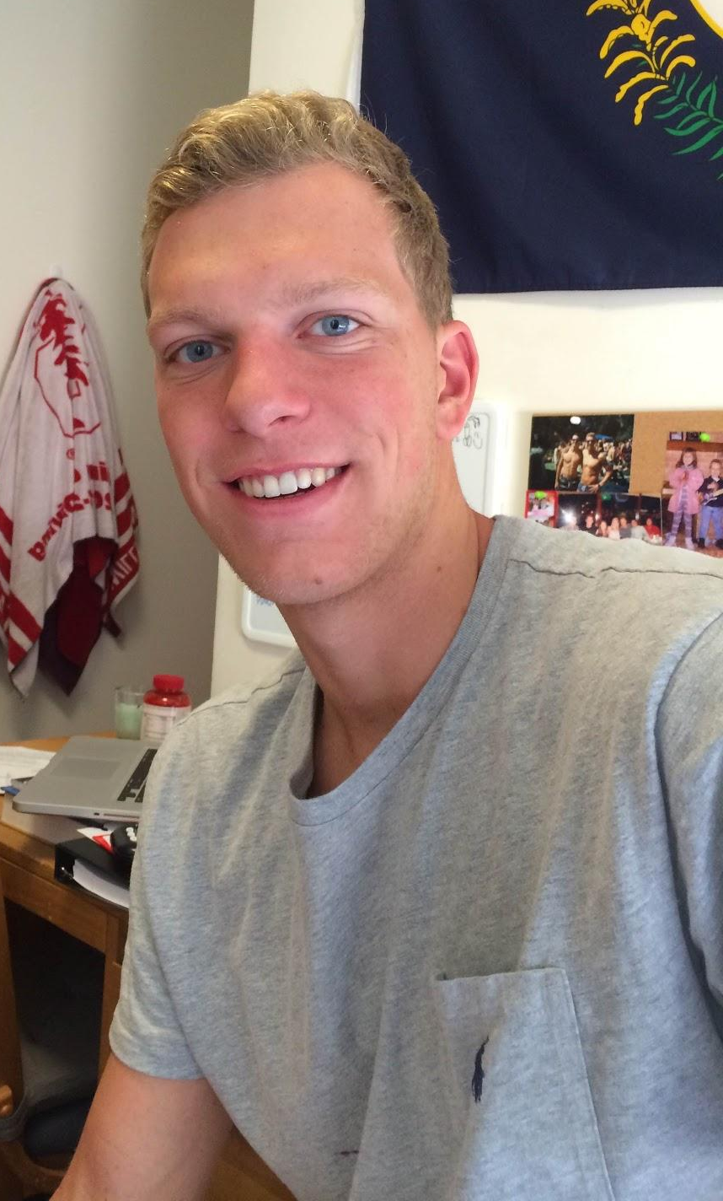
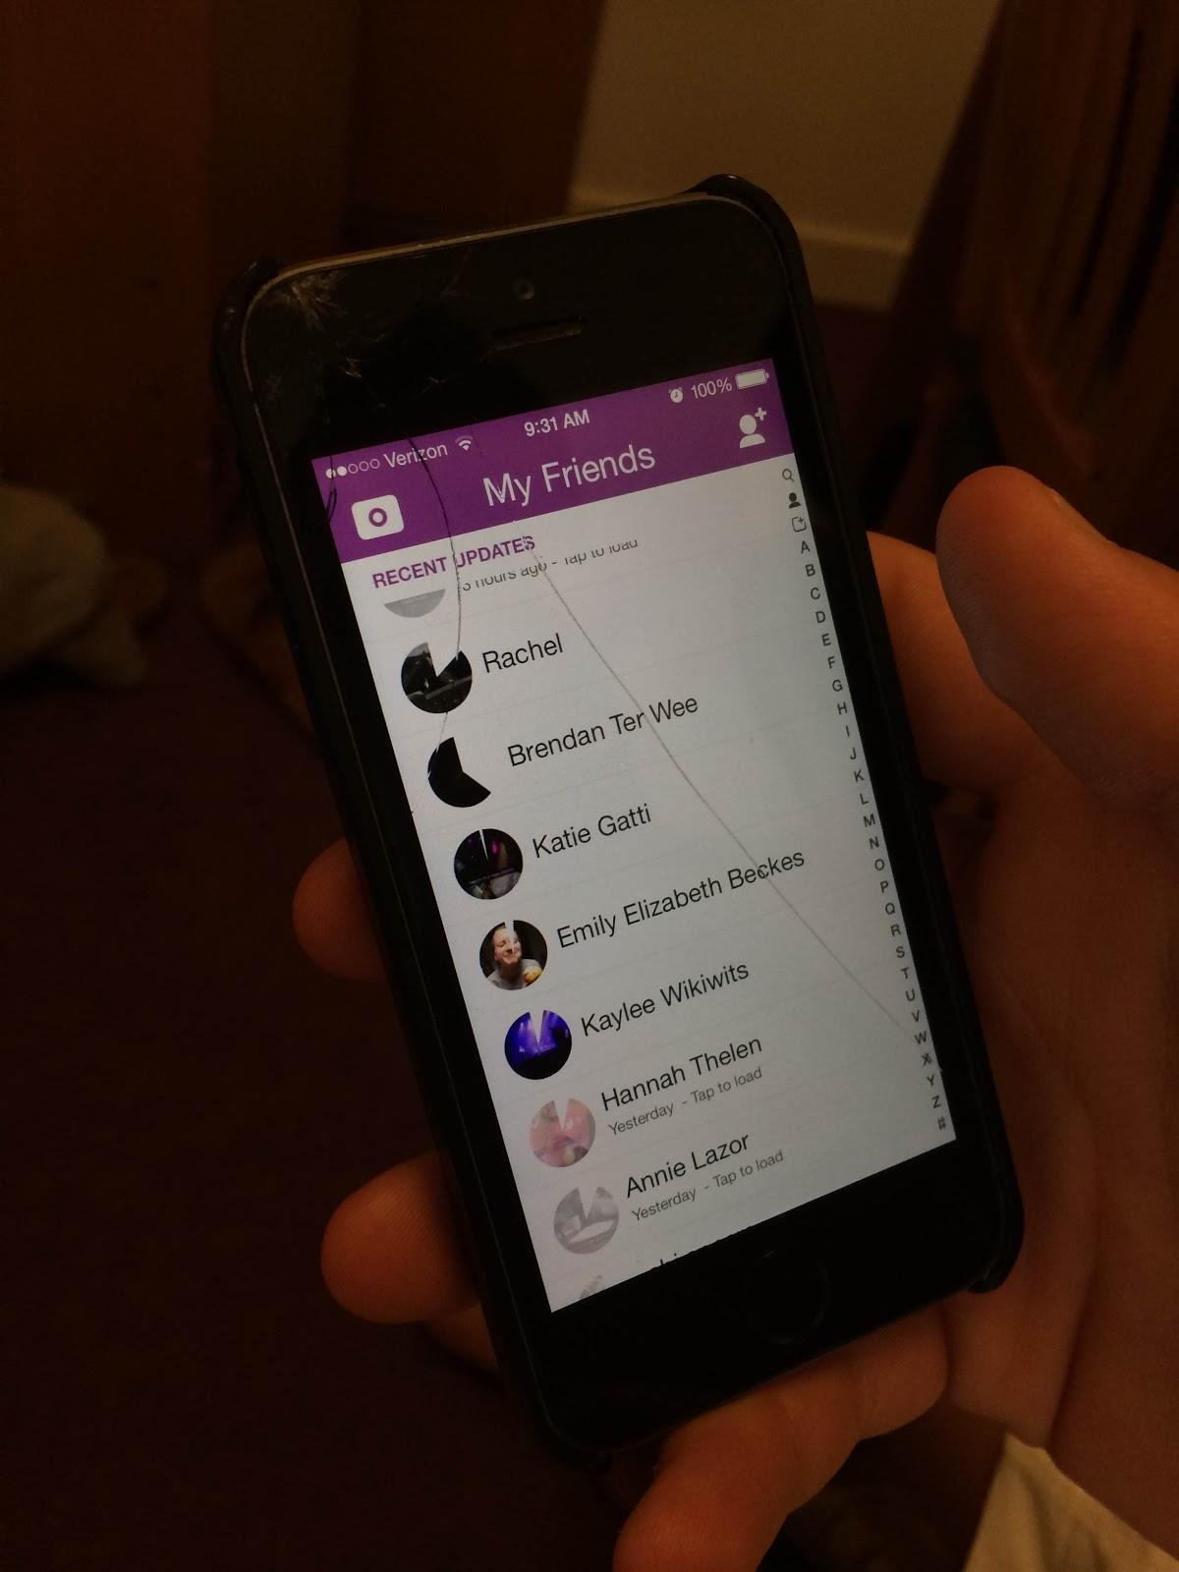
Contextual Inquiry (Desc. & Results)
Interview
Max
Chosen because of heavy Snapchat use
Recruited through friends, neighbors
Likes attending concerts and festivals
Fits largest demographic: college students
Interviewed in dorm room

Slide 7
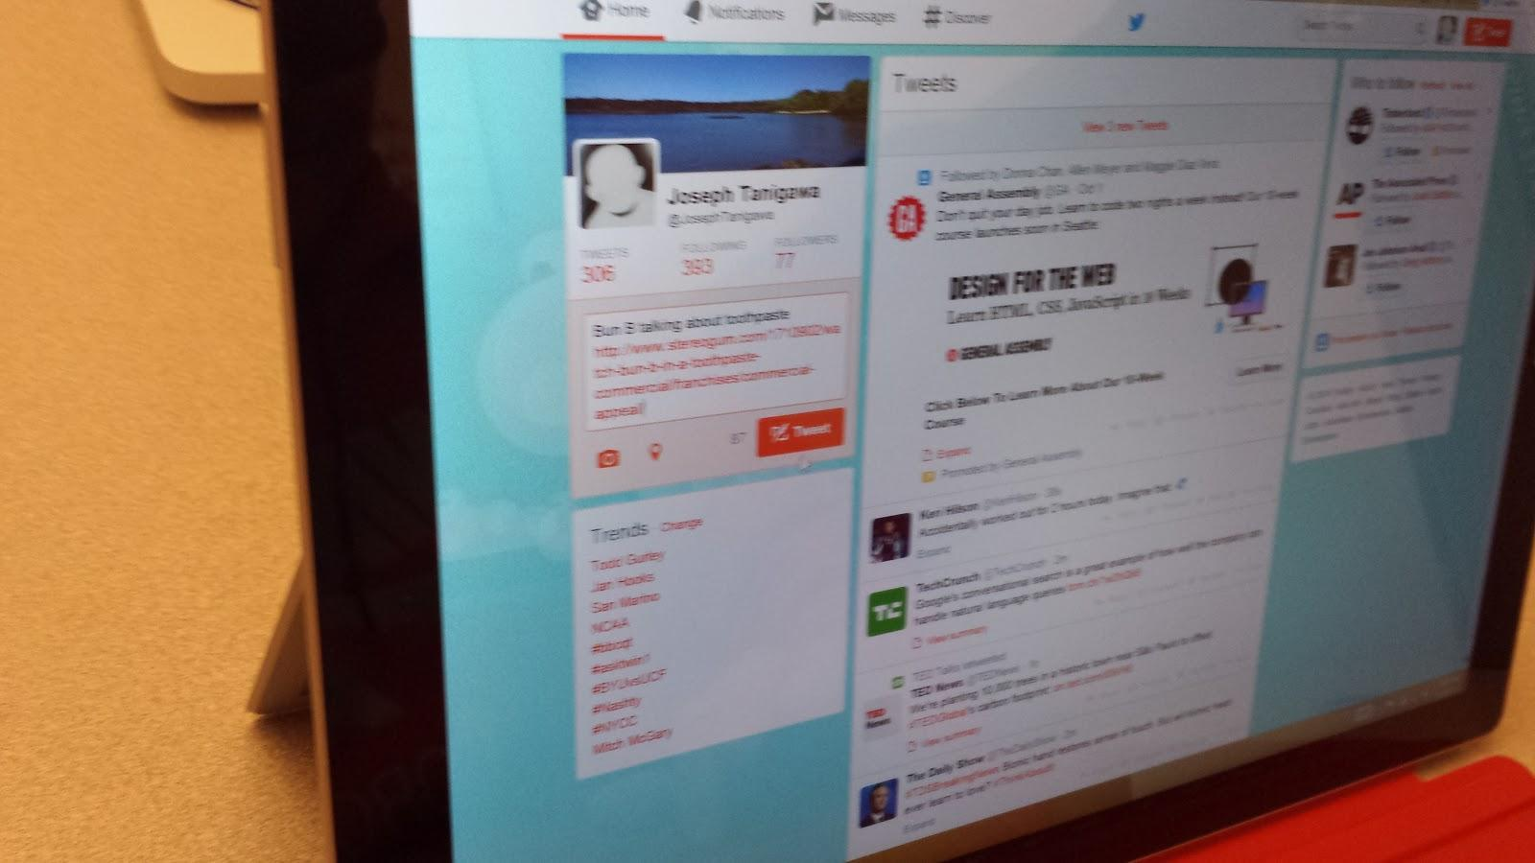
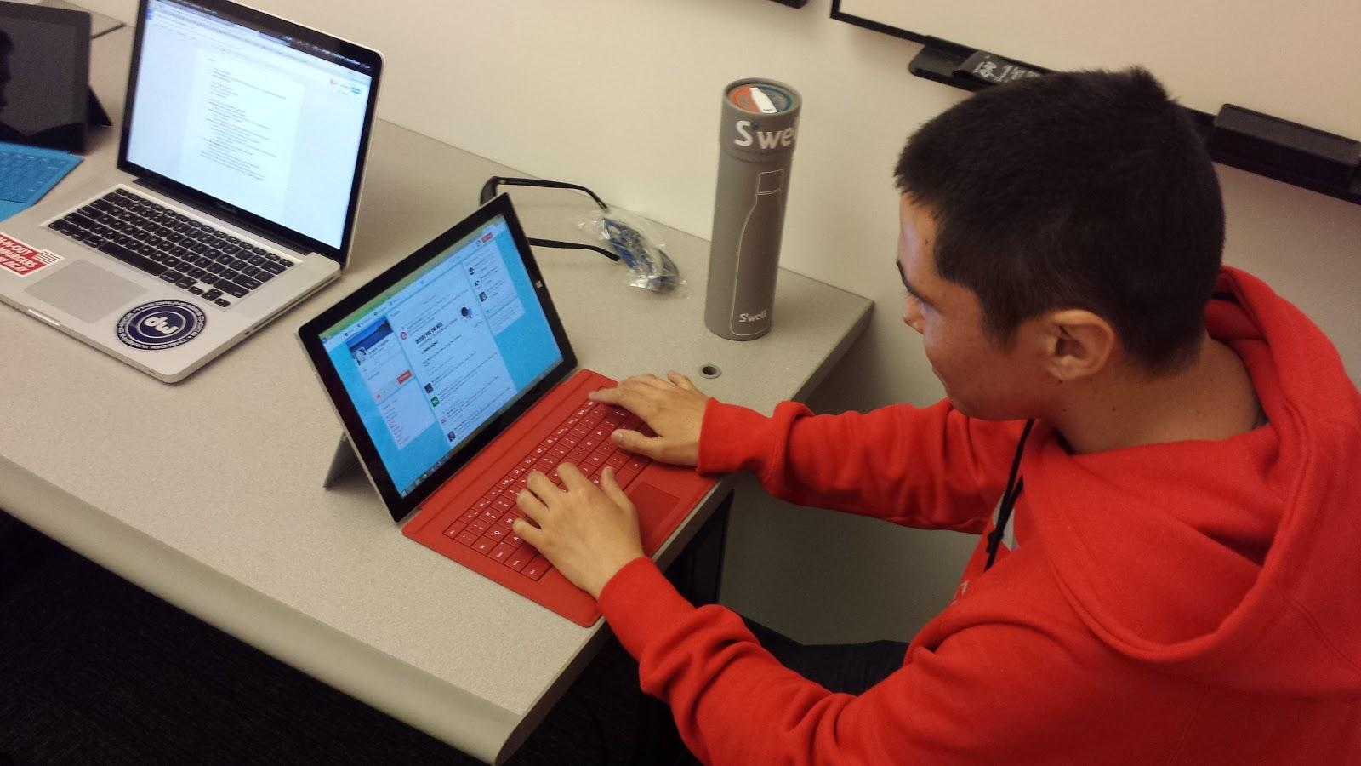
Contextual Inquiry (Desc. & Results)
Interview
Joseph
Chosen because he’s a primarily text-based social media user
Recruited because he works with a group member
Interviewed at the Microsoft Silicon Valley Campus

Slide 8
Contextual Inquiry (Desc. & Results)
Customers primarily used photos and text to share
Customers preferred anonymity and simplicity in their networks. Customers noted that no app allows for both
Customers approached each existing medium taking potential audience and content permanence into consideration

Slide 9
Task Analysis Results
Users:
Event goers and their friends
Tasks currently performed:
Sharing photos, videos, and text through fragmented social media

Slide 10
Task Analysis Results
Tasks they want:
Sharing content through one service
Browsing by event
Seeing non-friends’ content
How are tasks learned:
Intuitively

Slide 11
Task Analysis Results
Where tasks are performed:
Either on laptop or anywhere on mobile
Relationship between customer & data:
If sent to friends, less self-monitoring
If sent publicly, more careful
Friends vs followers

Slide 12
Task Analysis Results
Tools the customer has:
Instagram, Facebook, Snapchat, Twitter
User communication:
Sharing photos/videos
Curating content

Slide 13
Task Analysis Results
Frequency of tasks:
Between once a day and every few weeks
Time constraints:
Almost none
When things go wrong:
Users want to have control of own content
Have ability to delete

Slide 14
Representative Tasks
Simple: Submitting content
User wants to:
share their experiences of events with public/friends
medium in frequency
high in importance

Slide 15
Representative Tasks
Moderate: Curating content
User wants to:
see top content from events
provide input to other users content
high in frequency
high in importance

Slide 16
Representative Tasks
Complex: Browsing events
User wants to:
discover relevant and interesting events
notify friends which events they attend
medium in frequency
medium in importance

Slide 17
Application Ideas
#3
Focus on friend circles
Creation between groups
Private collections

Slide 18
Application Ideas
#2
Personal curating
Stitch together content and add music
Organize photos/videos/montages by event
Send to friends

Slide 19
Application Ideas
#1
Anonymously submit photos/videos on event page
Crowd voting to pick top content
Top content used in montage
Archived/Shared with friends

Slide 20
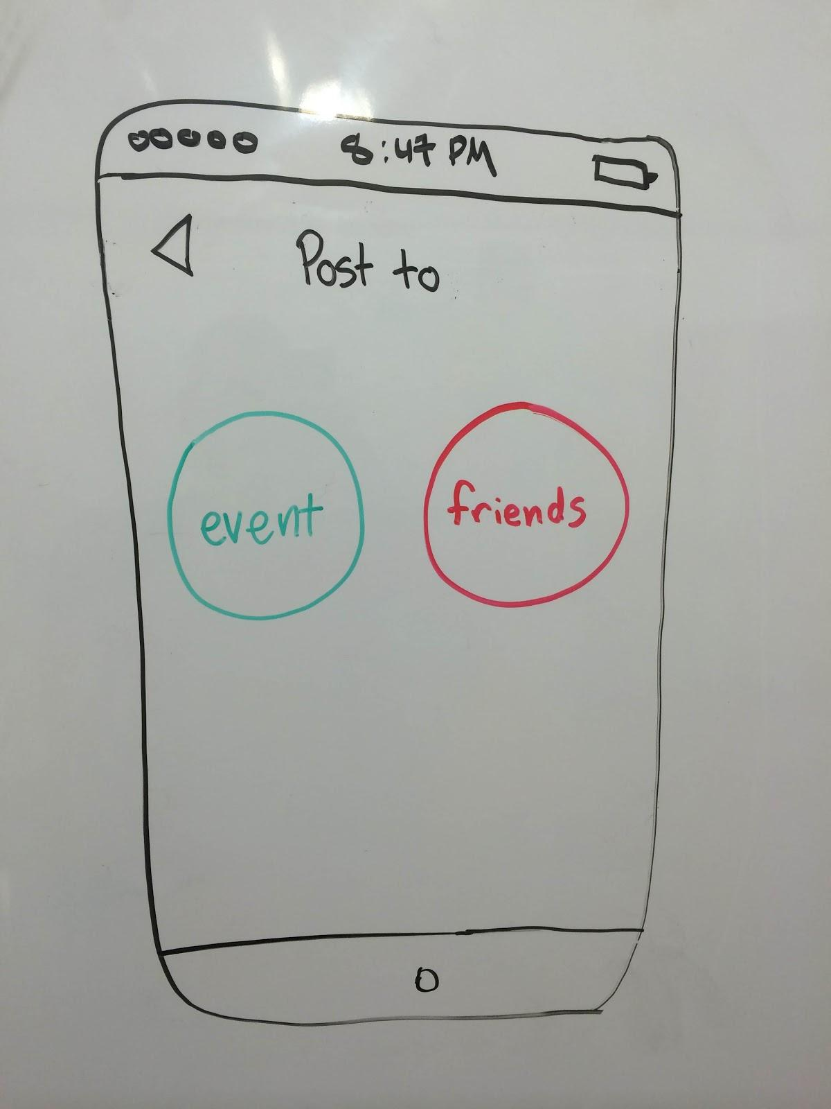
Early Design Sketches

Slide 21
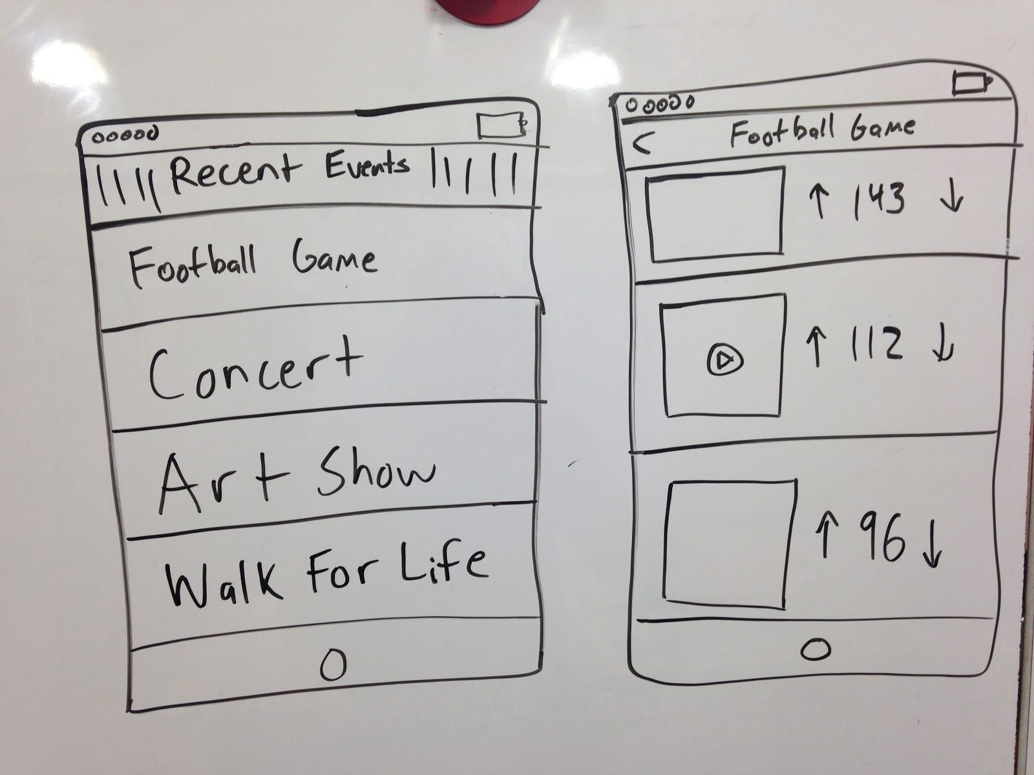
Early Design Sketches

Slide 22
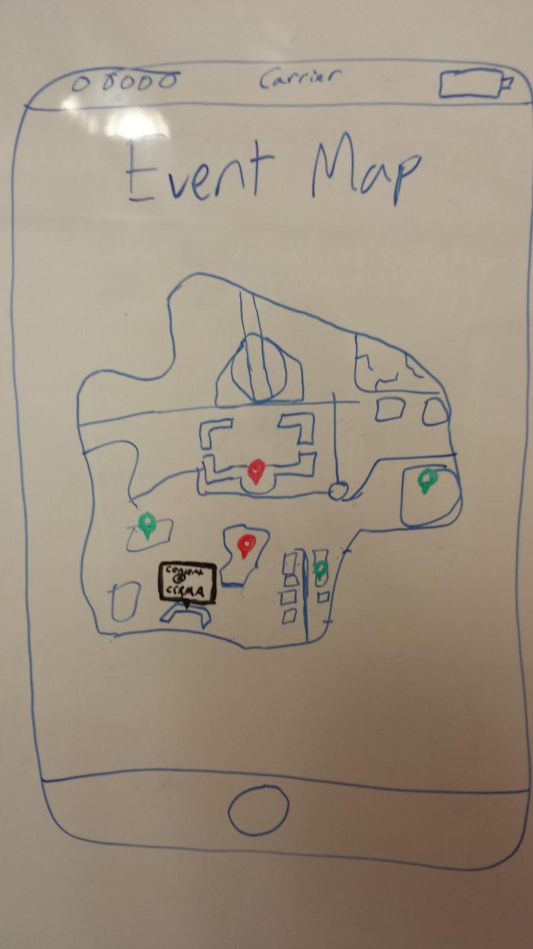
Early Design Sketches

Slide 23
Summary
Create a platform for creating and sharing crowdsourced content
Allows flexibility of private and public submissions
Little need for careful submitting through anonymity

